Slide 1
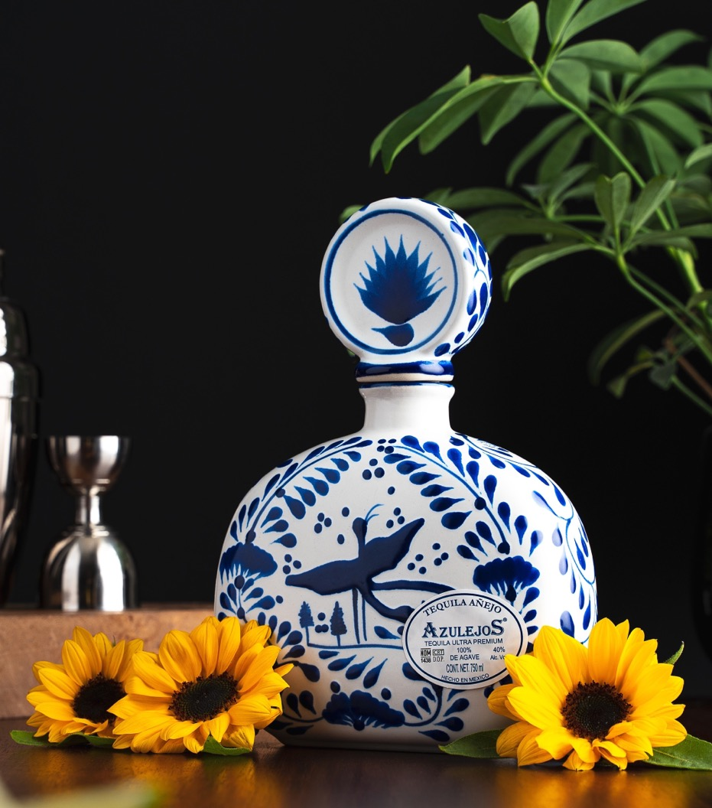

Artisan Tequilas

Slide 2
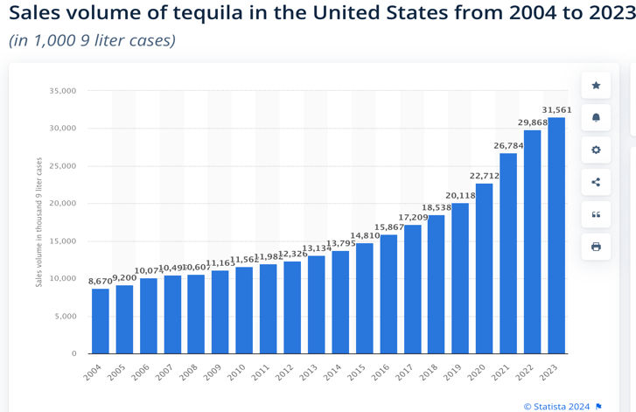

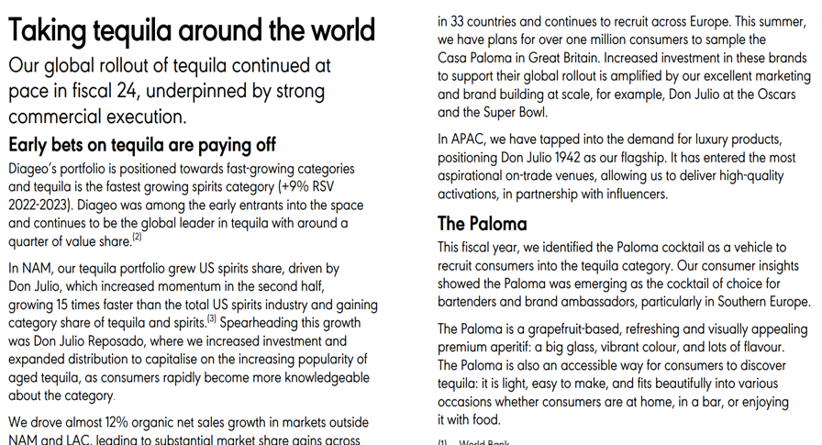
Why Premium Tequila?
In the United States Tequila revenue
outpaces all Whisky (#2 in Spirits Category after Vodka)
United States Compounded Annual
Growth Ultra Premium Tequila:
2016-2021 +34.5% Per year ($45-$99 avg bottle price)
2021-2026 +20.8% Per year *IWSR Data USA
For large suppliers like Diageo, premium
tequila is projected to surpass the combined global revenue of gin and vodka in 2025, making it their fastest-growing category and the second largest overall. Most major global suppliers are planning significant investments to grow the tequila category, aligning with global trends. Their strategies include incentivizing retailers, marketing directly to consumers through advertisements, and on-
premise promoting premium cocktails such as upscale Paloma and Margarita variations.

Slide 3
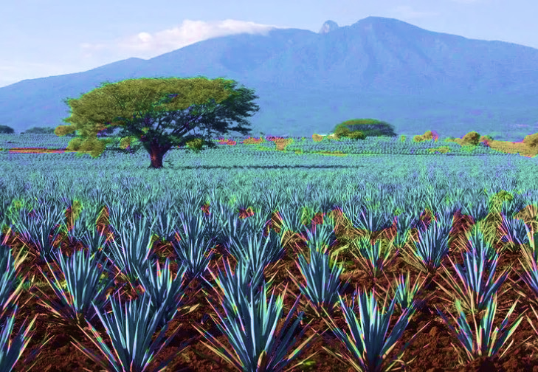

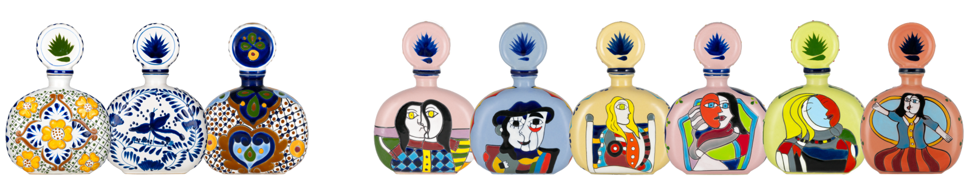
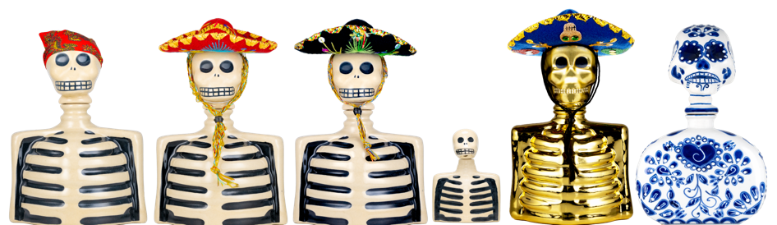
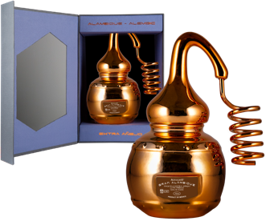
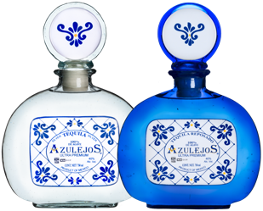
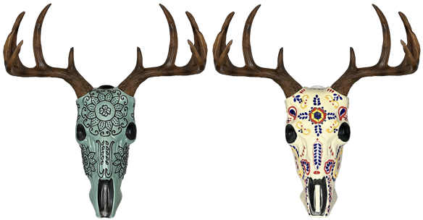
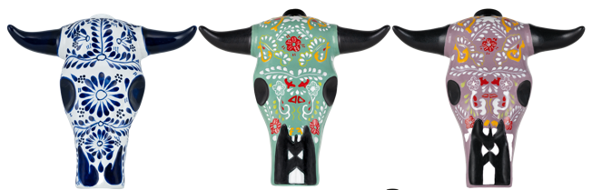
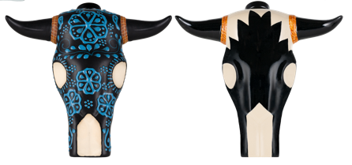

Slide 4
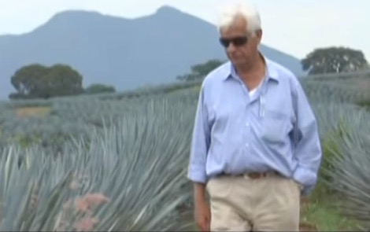
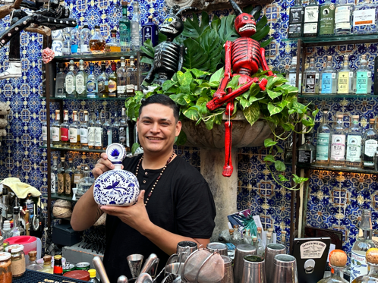
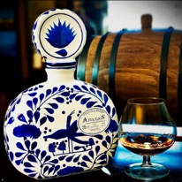
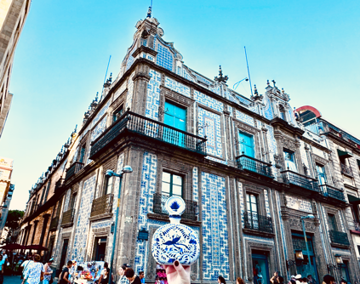
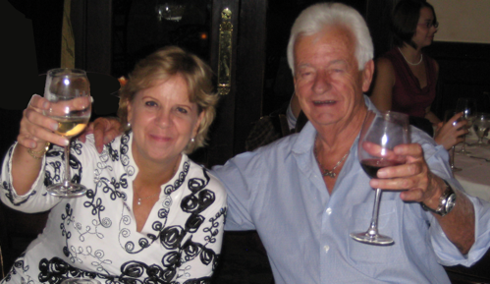
Our Story
Founded by my late father, Pedro Quintanilla, 30 years ago
when 99% of Tequila was low-end mixto.
Azulejos was the first Ultra-Premium tequila Created specifica-
lly to compete with luxury Cognac, Scotch, & Bour-
bon. This was also the first 100% Agave tequila
brand to showcase Mexican Art and Heritage.
Azulejos first to create Ceramic tequila bottles.
Our bottles were made to resemble hand-painted “azulejo” tiles
that decorate the most beautiful
homes and haciendas in Mexico. An
art tradition brought from Spain and
Portugal 500 years ago.
Currently the brands are owned
by Linda Quintanilla,one of ten female
owned Ultra-Premium Luxury Tequilas
Our Story Video: https://www.youtube.com/watch?v=KMSwhGe72Q4

Slide 5
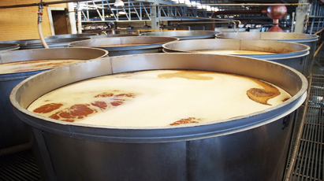
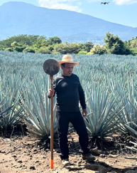
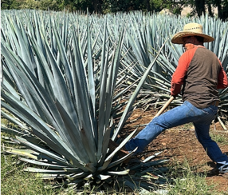
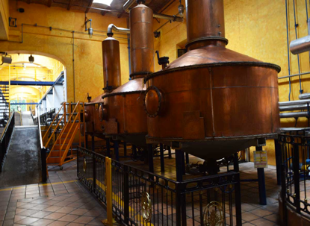
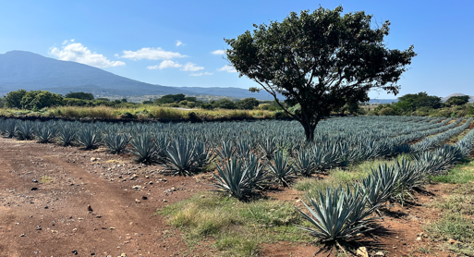
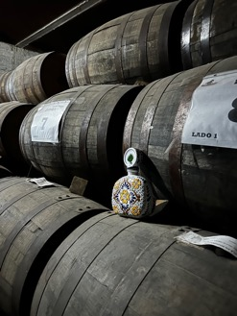
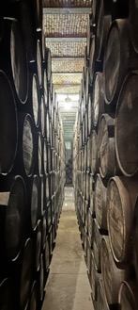
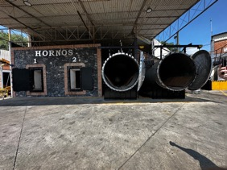
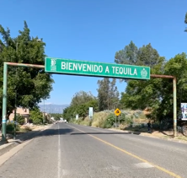
Our Process – Key Points
50% Highland Agaves, 50% Lowland Blue Weber Agaves
Agave is cooked traditional method (autoclaves & brick ovens)
Natural Fermentation
Double Copper Pot Distillation
Aged in a combination of Tennessee and Kentucky Bourbon Barrels
Our tequilas are additive free
Only Agave, Yeast & Water
All our products are 100% Agave tequilas produced and bottled in the town of Tequila, Jalisco, Mexico
Blanco or Silver - unaged
Reposado - 4-6 months
Añejo - 16-18 months
Extra Añejo - 3 years or more.
How are we made video:
https://www.youtube.com/watch?v=cVCUvaHDKKI

Slide 6
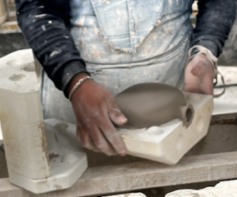
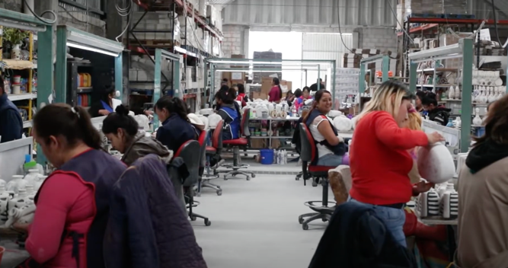
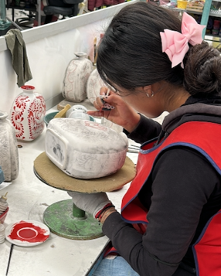
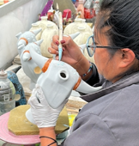
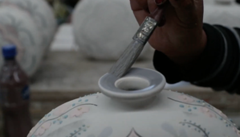
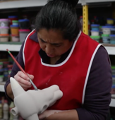
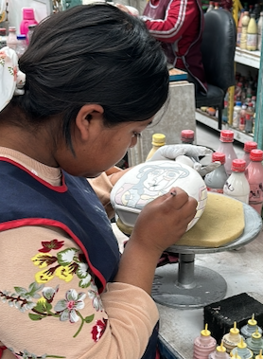
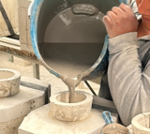
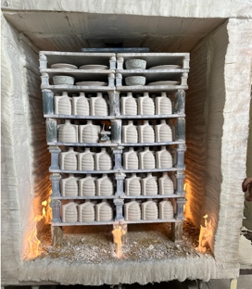
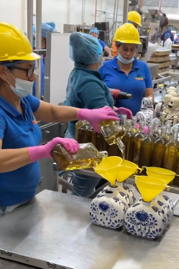
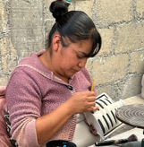
Our Process – Bottles
Our Ceramic Bottle artisan
facility is located in the mountains of central Mexico north of the city of Toluca.
We employ 16 female artisans
who meticulously hand-paint each individual bottle using 400 year old traditional methods passed down through generations. We pay fair wages to our employees.
Bottles, from start to finish
(moulding, painting, firing) take approximately 2 weeks to produce.
Bottles are made from ceramic
clay, which is earth, making it 100% environmentally friendly in comparison to other resources.
Our Bottle Production Process Video: https://www.youtube.com/watch?v=29c8OmGT6tI

Slide 7
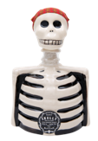
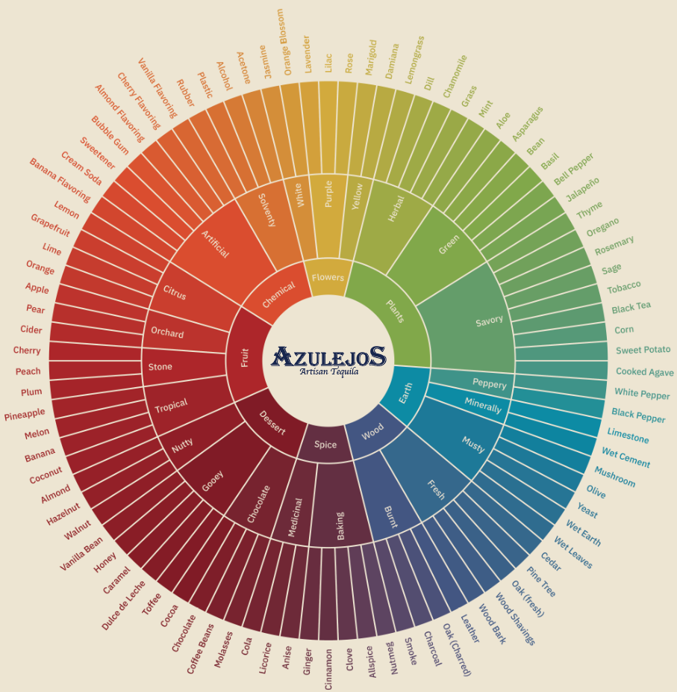

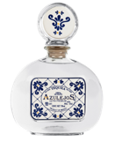

Blanco
Production Method: An authentic 100% Blue Weber Agave tequila made in the Traditional Method. Produced with fully mature 7-10 year agave from 50% Highlands and 50% Lowlands of Jalisco, slow-roasted in brick ovens, slow-fermented, never diffused, roller press extraction, double distilled, and additive free.
Aroma - Its opening bouquet is snappy, fresh, ashy and a touch smoky; pleasant agave notes emerge upon air contact. I nice bouquet of flowery aromas such as jasmine and rose which turn into rosemary, thyme and a hint of mint.
Palate - On the palate, the taste is fresh, pleasing, appropriately zesty, peppery and vegetal, with a hint of sugary sweetness at mid-palate. You have some solid minerality with some peppery yet subtle floral notes.
Finish - The aftertaste is long, pleasant, laced with honey & pepper. Crisp and notably refreshing

Slide 8
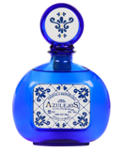

Reposado
Production Method: An authentic 100% Blue Weber Agave tequila made in the Traditional Method. Produced with fully mature 7-10 year agave from 50% Highlands and 50% Lowlands of Jalisco, slow-roasted in brick ovens, slow-fermented, never diffused, roller press extraction, double distilled, Bourbon Barrel Aged 6 months, and additive free.
Aroma - Initial nosing passes are orange blossom, with some basil evolving to hazelnut & nutmeg.
Palate - Palate entry is properly tart, acidic and lean; mid-palate features a strong firmly structured texture and flavor of honey oak, and vanilla bean yet with herbal agave notes still present.
Finish - Finishes long, with both some toffee and vegetal notes. A reposado whose naturally sweet disposition is its finest asset.

Slide 9
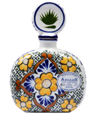

Añejo
Production Method: An authentic 100% Blue Weber Agave tequila made in the Traditional Method. Produced with fully mature 7-10 year agave from 50% Highlands and 50% Lowlands of Jalisco, slow-roasted in brick ovens, slow-fermented, never diffused, roller press extraction, double distilled, Bourbon Barrel Aged 18 months, and additive free.
Aroma - Roasted-pineapple opening aroma; more time in the glass allows a peppery almost viscus, floral perfume to develop. Nice aromas of toasted oak and vanilla bean also emerge.
Palate - palate entry shows roasted peppers, orange blossom, and tropical fruit. Then the mid-palate showcases luscious flavors of chocolate, orange, and sugar cookies.
Finish - Aftertaste is naturally sweet, sugary and long. A ton of chocolate, caramel, and dulce de leche flavors are very notable. This is the choice of the most sophisticated consumers searching for the full-body obtained from the more dominant wooden essence.

Slide 10
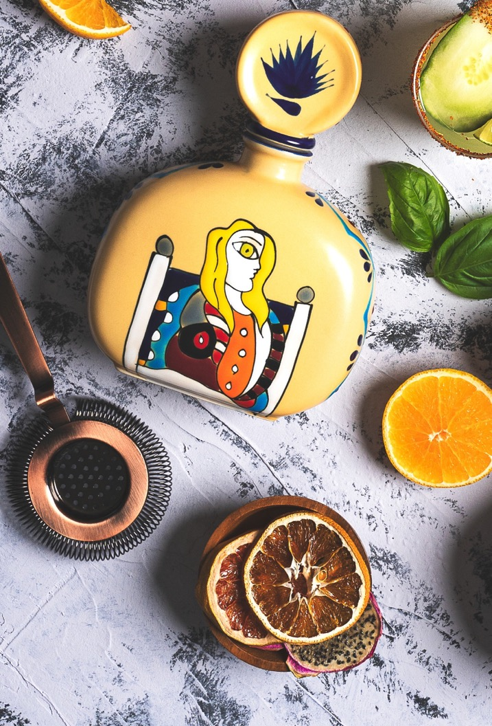
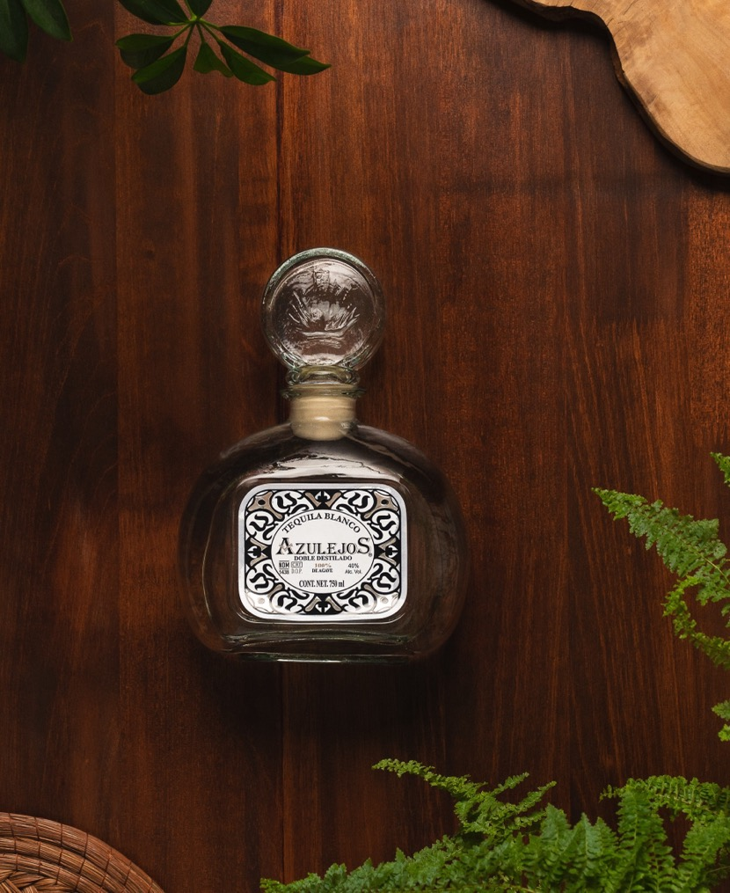
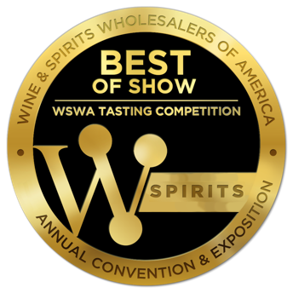
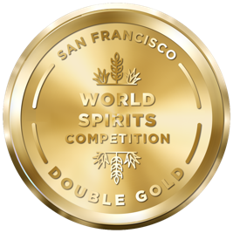
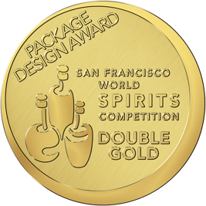
Awards/Medals:
Wine & Spirits Wholesales of America (WSWA)
Azulejos Añejo: Double Gold - Best Tequila of Show
Skelly Añejo: Double Gold - Best Overall Spirit of Show 500+ Entries
San Francisco World Spirits Competition
Azulejos Añejo: Double Gold Medal (Unanimous)
Skelly Añejo: Double Gold Medal (Unanimous)
28

Slide 11

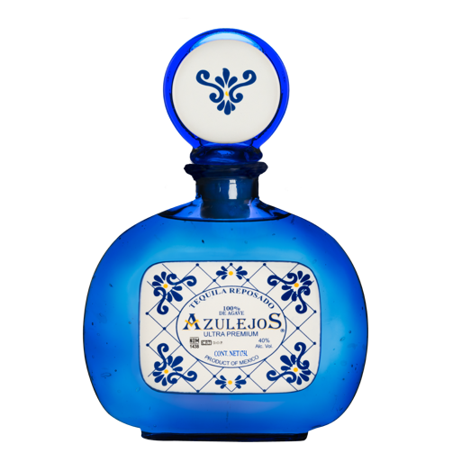


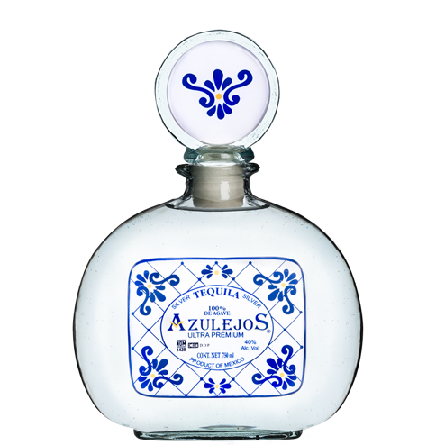
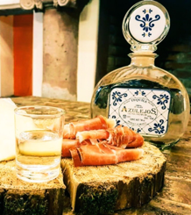
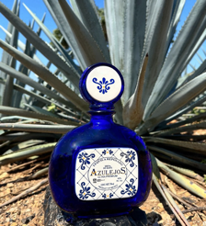





Azulejos Classic
Collection
Blanco is contained in
transparent recycled artisan glass bottle with ceramic “azulejo tile” label.
Reposado is contained in a
real cobalt glass artisan bottle also with a ceramic “azulejo tile” label.
The fusion of two very
Important Mexican art styles (artisan glass and ceramic) make this bottle extremely unique.

Slide 12












Azulejos Talavera
Collection
Mexican Hand-Painted ceramic
in the style of “azulejo tiles” label.
All three unique intricate design
in every case (2 bottles of each)
This decanter bottle is a piece of
art on its own and will never be thrown away. Great option for a luxury spirits collector as well as people who appreciate art.

Slide 13


















Azulejos Masterpiece
Collection
Mexican Hand-
Painted ceramic “Masterpiece” Art bottles.
All six intricate
designs in each case.
Great for any Art
& Spirits Collection!

Slide 14
















Skelly Collection
Skelly is our brand made in honor of the Mexican “Day of the Dead” festival. Day of the Dead is celebrated on November 2nd, All Soul’s Day.
Skelly has a smile because this holiday is a celebration of life; an opportunity to have a large family meal with recipes that have been handed down for generations, and an evening where you speak about your ancestors and where your family came from. The night may or may not end with large amounts of tequila consumed accompanied by some nostalgic mariachi music!
Skeletons, in Mexican Culture, represent art and the love of life as we will all end up as skeletons eventually, so live life to the fullest while you
are here and enjoy the beauty around us. Our Skelly Bottles are made from Mexican ceramic and hand-painted. Our Blanco is available with a bandana and our Reposado and Anejo bottles come in hand-sewn Mariachi hats. We also have a ceramic Skelly Mini 50ml and limited edition Skelly Gold and Skelly Talavera decanter bottle.

Slide 15







Trophy Head Collection
These ceramic hand-painted bottles are made in remembrance of the 1st art form found in America, painted skulls from over 10,000 years ago.
Built in hanger ring to be able to hang on wall. Two different presentations in each case.

Slide 16



Gran Alambique Extra
Añejo 100% Agave
Tequila Azulejos is extremely proud of our most exclusive presentation called “Gran Alambique”, the Great Alembic Still. This elegant design will make its grand debut in the world of exclusive tequilas in September 2023.
As the name implies it is contained, in an elegant alembic still, which is an ancient metal instrument used for the distillation of perfumes, medicines, and finally the best spirits. The metallic copper coating on this ceramic bottle, is characteristic of the oldest alembic stills dating back to the days of Cleopatra. This high-end bottle contains a 100% Blue Weber agave Extra Añejo Tequila, making this collection an exclusive experience for the most demanding palates.
Extra Añejo 750ml with box

Slide 17




Key Points
Founded Thirty Years Ago, Was the 1st Ceramic Tequila
Azulejos Priced 30% below Clase Azul
Art In Tequila, Art In the Bottles
Supports Mexican Artisans
Woman Owned, Women Artisans, Women Bottlers
San Francisco World Spirits Competition Multiple Double Gold Medals
Additive Free, not sweet, not syrupy, same recipe for 30 years
Target Consumers: Spirits Collectors, Art Enthusiasts, Impulse Buyers, E-Commerce. (Largest Demographics Suburban Women 25-60)
Almost 40,000 Social Media Followers.
Our products are not price sensitive, so everyone across the chain can make good margins and have fun selling our brands and make money.
Tequila is the fastest growing spirits category in the industry and is here to stay with global projected compound growth of 20%-30%+ per year.

Slide 18





CONTACT INFORMATION
Chris Quintanilla cquintanilla@azulimports.com C: +1-832-291-7721
azulejostequila.com
@tequila.azulejos
IF YOU HAVE A MINUTE PLEASE FOLLOW US
TequilaAzulejos
THANK YOU, EVERY BOTTLE MEANS THE WORLD TO OUR TEAM

